Slide 1

Axis Insurance
By
Lavina Kunder

Slide 2

BACKGROUND
Insurance can protect you financially in a number of ways
Accidents and disasters can and do happen, and if you aren't adequately insured, it could leave you in financial ruin.
You need insurance to protect your life, your ability to earn income, and to keep a roof over your head.

Slide 3
PROBLEM DEFINITION
OBJECTIVE:
Statistical Analysis of Business Data.
Explore the dataset and extract insights from the data using EDA.
QUESTIONS / FURTHER EXPLORATION:
(1) Prove (or disprove) that the medical claims made by the people who smoke is greater than those who don't?
(2) Prove (or disprove) with statistical evidence that the BMI of females is different from that of males.
(3) Is the proportion of smokers significantly different across different regions?
(4) Is the mean BMI of women with no children, one child, and two children the same? Explain your answer with statistical evidence.

Slide 4
DATA INFORMATION
The data is for customers of the treadmill product(s) of a retail store called Cardio Good Fitness. It contains the following variables:
Name | Type | Information
Age | Integer | Range from 18 to 64
Sex | Object (String) | Male / Female
BMI | Float | Range from 15.96 to 53.13
Children | Integer | Range from 0 to 5
Smoker | Object (String) | Yes / No
Region | Object (String) | 4 unique regions
Charges | Float | Ranges from 112.87 to 63,770.43 $
There are a 1338 rows and 7 columns
There are no missing or duplicated values

Slide 5
UNIVARIATE ANALYSIS

Slide 6
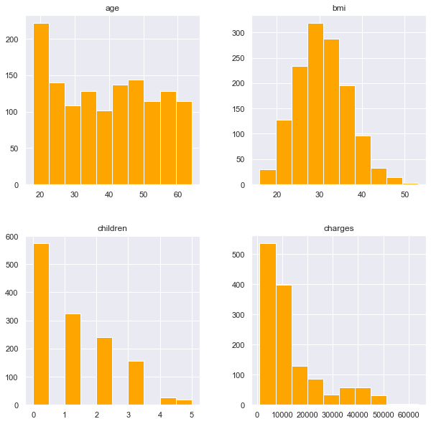
Histogram Plots
Histogram Plots of the various numerical Attributes present in the given Dataset. It shows the frequency of each element within the attribute.

Slide 7
Observations
Age has the maximum concentration in the range of 20 to 30 years, implying that most customers are in that age range.
Most people have a BMI in the late 20's and early 30's.
A Large number of people have no children with very few having over 3 children.
Most charges are in the range of 0 - 20,000 dollars; with comparatively less cases above that range.

Slide 8
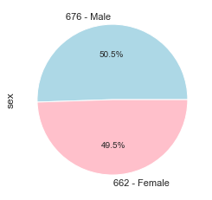
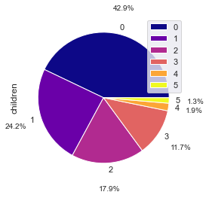
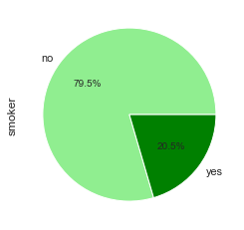
Variable Analysis
The Dataset is almost evenly distributed between Male and Female with Male leading only by a very small margin
Most people have no children. Almost 50% of the population has 1, 2 or 3 kids. Less than 4% have 4 or 5 kids.
Almost 80 percent of the people in the dataset do not smoke. Only 20% do.

Slide 9
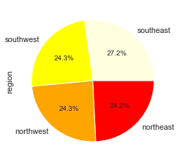
Variable Analysis
The entire dataset seems to be evenly distributed amongst the 4 regions. South - East leads by a very small margin of approximately 3 percent.

Slide 10
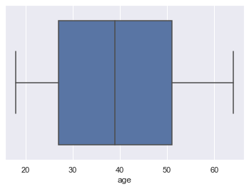
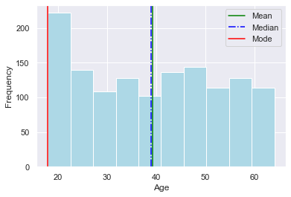
Age
The Mean and Median and relatively close values averaging at 39 although, a large chunk of the population is in their 20's. Age attribute has no outliers.

Slide 11
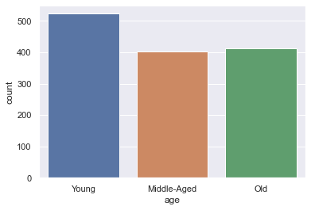
Age
The Data Set has a higher concentration of Young Policy Holders with Middle-Aged and Old policyholders having relatively the same concentration

Slide 12
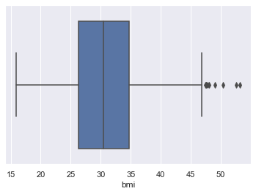
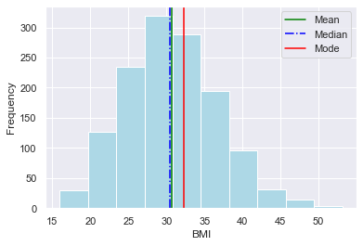
BMI
The Mean and Median and relatively close values averaging at 30 with a large chunk of the population lying in the range 25 - 35. The BMI attribute also has a few outliers.

Slide 13
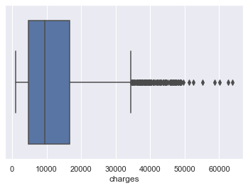
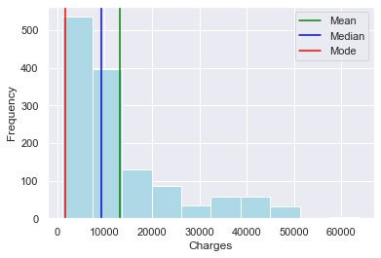
Charges
A large chunk of the population in the dataset is concentrated in the 0 - 15000 range. Comparatively, very few people lie above this range. The attribute Charges has a lot of outliers.

Slide 14
BIVARIATE ANALYSIS

Slide 15
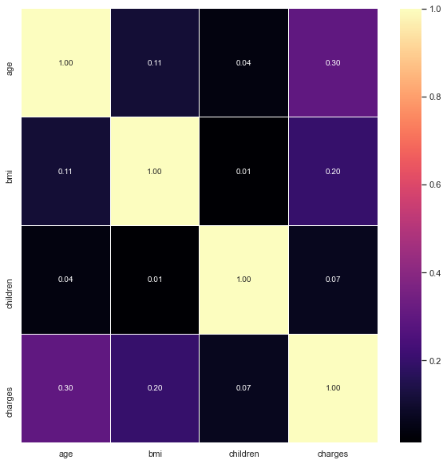
Correlation Heat Map
This Heat Map shows the correlation between the individual attributes. With this we can draw the following inferences :
1) There is very little to negligible correlation between the attributes of this dataset.
2) The Highest Correlation is between 'Charges' and 'Age' with 0.30.
3) The Lowest Correlation is between 'BMI' and 'Children' with 0.01.
4) These atrributes are mostly independent.

Slide 16
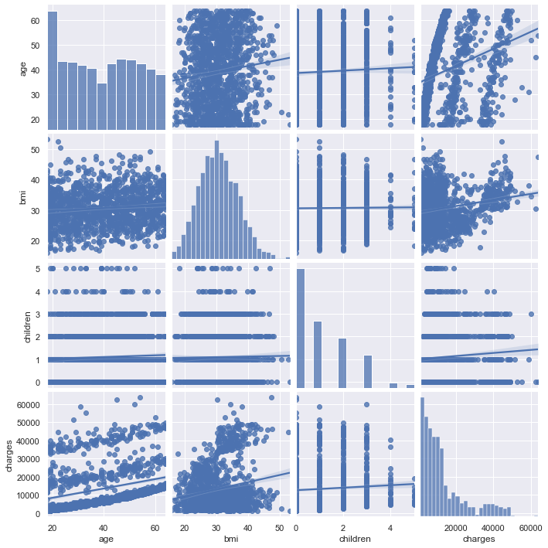
Pair Plot

Slide 17
Pair Plot

Slide 18
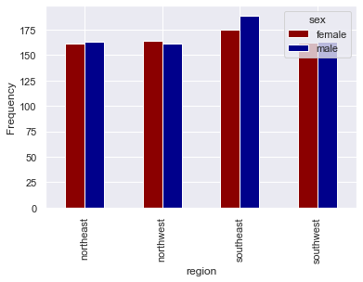
SEX V/S REGION
OBSERVATIONS
The Male insurance beneficiaries exceed the Female ones in all regions except one (North West).
The region that most beneficiaries reside in is South East.

Slide 19
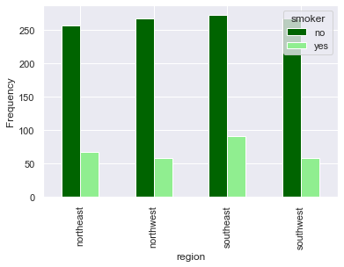
REGION V/S SMOKER
OBSERVATIONS
While the non smoking population is relatively equal in all 4 regions; the smoking population has an elevated difference with SouthEast having the most, followed by NorthEast at 2nd place and NorthWest and SouthWest placed 3rd with relatively equal distribution

Slide 20
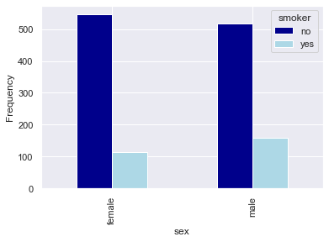
SEX V/S SMOKER
OBSERVATIONS
SMOKER : More Male Policy Holders than Female.
NON-SMOKER : More Female Policy Holders then Male.

Slide 21
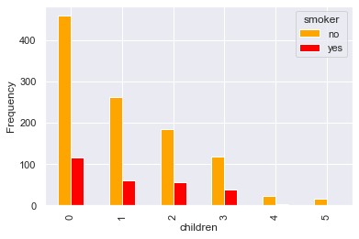
CHILDREN V/S SMOKER
OBSERVATIONS
As the number of children / dependants increase; there is a decline in the smoking population.
There are no smoking policy holders with 4 or 5 children / dependants.

Slide 22
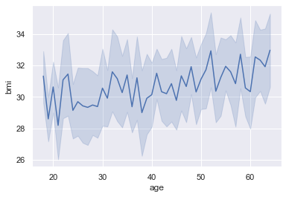
BMI V/S AGE
OBSERVATIONS
On an average; as Age increases the BMI also increases.

Slide 23
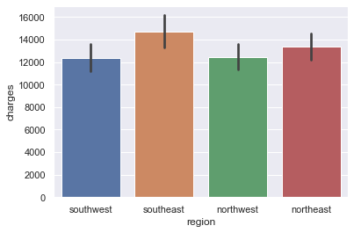
CHARGES V/S REGION
OBSERVATIONS
The SouthEast region has the highest charges followed by NorthEast. SouthWest and NorthWest are next with relatively same average charges.

Slide 24
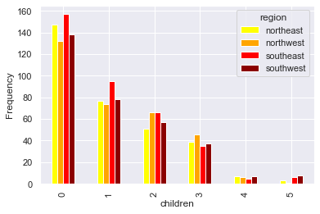
CHILDREN V/S REGION
OBSERVATIONS
SouthEast Region has the highest policyholders with 0, 1 or 2 children / dependants.
SouthWest Region as compared to the other regions, policyholders have less number of children / dependants.
The NorthEast region has a higher number of policyholders with 0 children / dependants but the number falls as the children / dependants increase.
The NorthWest region has no policyholders with 5 children / dependants.

Slide 25
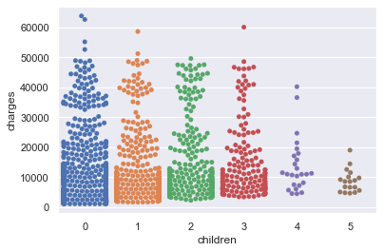
CHILDREN V/S CHARGES
OBSERVATIONS
Data on Policy Holders decreases as Number of Children / Dependants Increases,
The highest charges come from Policy Holders with 0 children / dependants and seems to decrease as children/dependants increase

Slide 26
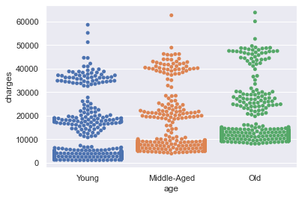
AGE V/S CHARGES
OBSERVATIONS
Older Policy Holders have significantly more charges than the Younger Policy Holders
As Age increases, charges increases.

Slide 27
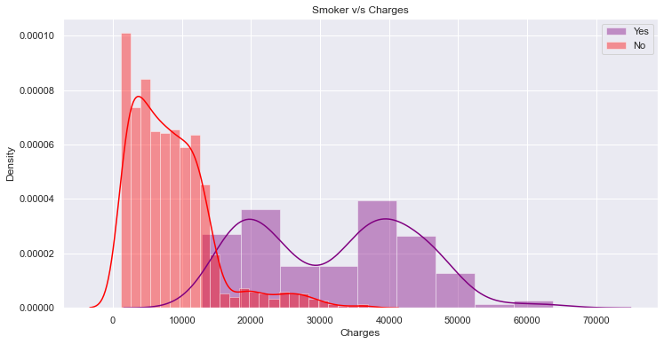
SMOKER V/S CHARGES
OBSERVATIONS
The Smoking Policy Holders have comparatively higher charges than the Non - Smoking Policy Holders

Slide 28
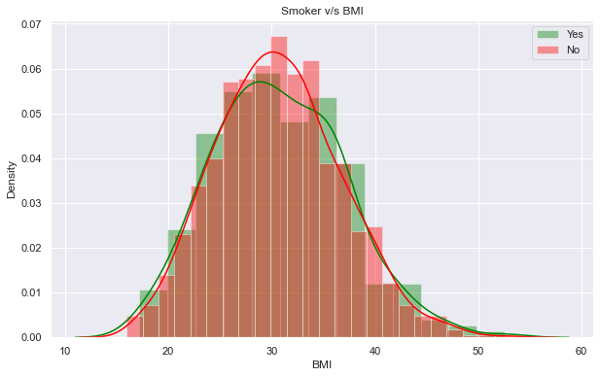
SMOKER V/S BMI
OBSERVATIONS
The Smoking Policy Holder's and Non - Smoking Policy Holder's BMI Distribution does not vary significantly and is more or less the same.

Slide 29
MULTIVARIATE ANALYSIS

Slide 30
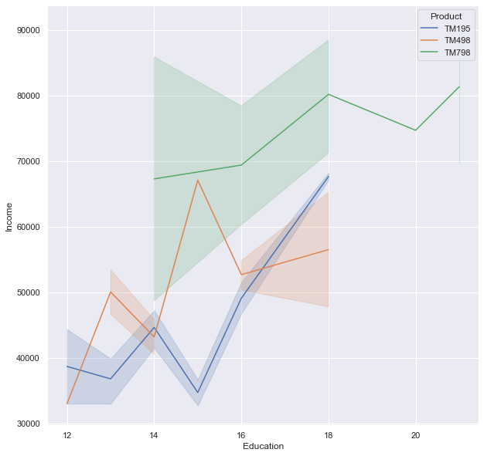
Relationship of Education, Income and Product
OBSERVATIONS
Customers with lower income (30,000 to 50,000) and years of education ranging from 12 to 18 prefer the TM195 Treadmill.
Customers with slightly higher incomes (50,00 to 70,000) and years of education ranging from 12 to 18 prefer the TM498 Treadmill.
Customers with high income (60,000 to 80,000+) and years of education ranging from (14 to 20+) prefer the TM798 Treadmill.
From this we can understand:
The TM798 Treadmill is the most expensive followed by the TM498 and lastly the TM195
Education and Income are directly proportional. (Higher the Education, higher the Income)
Customers with higher income and more years of education prefer the the TM798 model. Customers with mediocre income prefer the TM498 and those with even lower income prefer the TM195

Slide 31
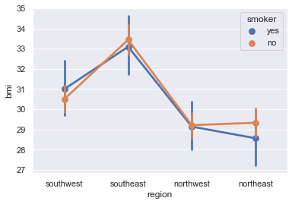
REGION V/S BMI V/S SMOKER
OBSERVATIONS
SOUTH-EAST : Has the highest range of BMI when compared to other regions. Non-Smokers have higher BMI than the Smokers.
SOUTH-WEST : Second Highest Range for BMI when compared to other regions. Smokers have higher BMI than the Non-Smokers.
NORTH-WEST : Third Highest Range for BMI when compared to other regions. Smokers and Non-Smokers have relatively the same BMI.
NORTH-EAST : Lowest Range for BMI when compared to the other regions. Non-Smokers have significantly higher BMI than the Smokers.

Slide 32
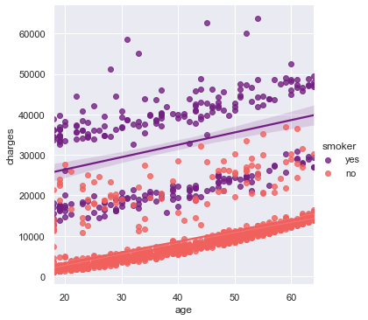
CHARGES V/S AGE V/S SMOKER
OBSERVATIONS
With the rise of age, the charges also rise.
The Smoking Policy Holders have higher Charges than the Non - Smoking Policy Holders

Slide 33
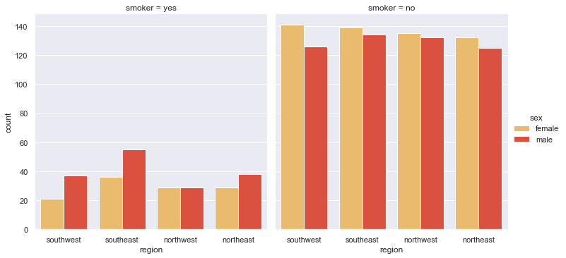
REGION V/S SMOKER V/S SEX
OBSERVATIONS
SMOKERS : North-West has equal Male and Female Smokers while all other regions have more Male Smokers than Female.
NON-SMOKERS : All regions have more Female Non-Smokers than Male ones.

Slide 34
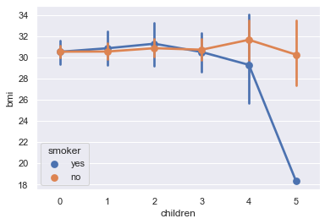
BMI V/S CHILDREN V/S SMOKER
OBSERVATIONS
SMOKERS : As the number of children/dependants increase from 0 to 3; BMI is in the range of 28 to 33. On further increase to 4, it drops to 28-30 and there is a sharp drop when it reaches 5 children/dependants to 18
NON-SMOKERS : BMI averages on the range of 28 - 33 for any number of children.

Slide 35
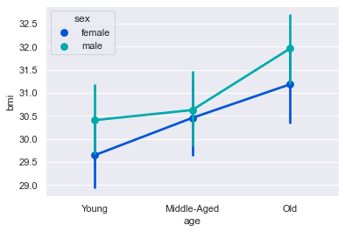
AGE V/S BMI V/S SEX
OBSERVATIONS
Males have a higher BMI than Females across all ages.
BMI Increases as Age increases.

Slide 36
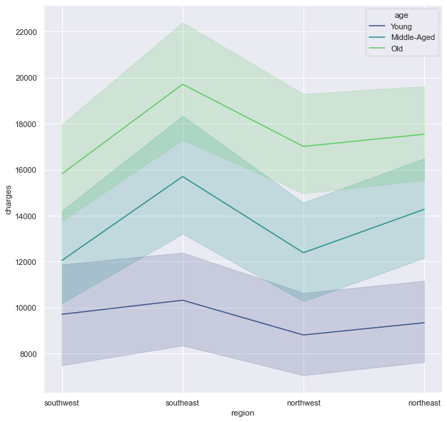
CHARGES V/S REGION V/S AGE
OBSERVATIONS
YOUNG : Charges range from 8000 to 12,000 with all 4 regions having similar averages with slight margins.
MIDDLE AGED : Charges range from 10,000 to 18,000. Steep Differences in the average charges of the 4 regions.
OLD : Charges range from 14,000 to 23,000. Steep Differences in the average charges of the 4 regions.

Slide 37
Key Insights based on EDA
Age has the maximum concentration in the range of 20 to 30 years, implying that most customers are in that age range.
Most people have their BMI in the late 20's and early 30's.
A Large number of people have no children with very few having over 3 children.
Most charges are in the range of 0 - 20,000 dollars; with comparatively less cases above that range.
The DataSet has a higher concentration of Young Policy Holders with Middle-Aged and Old policyholders having relatively the same concentration.
The Dataset is almost evenly distributed between Male and Female with Male leading only by a very small margin
Most people have no children. Almost 50% of the population has 1, 2 or 3 kids. Less than 4% have 4 or 5 kids.
Almost 80 percent of the people in the dataset do not smoke. Only 20% do.

Slide 38
Key Insights based on EDA
The entire dataset seems to be evenly distributed amongst the 4 regions. South - East leads by a very small margin of approximately 3 percent.
There is very little to negligible correlation between the attributes of this dataset.
The Male insurance beneficiaries exceed the Female ones in all regions except one (North West).
The region that most beneficiaries reside in is South East.
While the non smoking population is relatively equal in all 4 regions; the smoking population has an elevated difference with SouthEast having the most, followed by NorthEast at 2nd place and NorthWest and SouthWest placed 3rd with relatively equal distribution.
SMOKER : More Male Policy Holders than Female; NON-SMOKER : More Female Policy Holders then Male.
As the number of children / dependants increase; there is a decline in the smoking population.
There are no smoking policy holders with 4 or 5 children / dependants.

Slide 39
Key Insights based on EDA
On an average; as Age increases the BMI also increases.
The SouthEast region has the highest charges followed by NorthEast. SouthWest and NorthWest are next with relatively same average charges.
The highest charges come from Policy Holders with 0 children / dependants and seems to decrease as children/dependants increase
The Smoking Policy Holders have comparatively higher charges than the Non - Smoking Policy Holders
The Smoking Policy Holder's and Non - Smoking Policy Holder's BMI Distribution does not vary significantly and is more or less the same.
SMOKERS : North-West has equal Male and Female Smokers while all other regions have more Male Smokers than Female; NON-SMOKERS : All regions have more Female Non-Smokers than Male ones.
Males have a higher BMI than Females across all ages.

Slide 40
Key Insights based on EDA
BMI Increases as Age increases.
YOUNG : Charges range from 8000 to 12,000 with all 4 regions having similar averages with slight margins.
MIDDLE AGED : Charges range from 10,000 to 18,000. Steep Differences in the average charges of the 4 regions.
OLD : Charges range from 14,000 to 23,000. Steep Differences in the average charges of the 4 regions.

Slide 41
Recommendations based on EDA
As the Smoking population has higher charges; the insurance company can charge them higher premiums to keep up with the costs as well as discourage smoking.
More targeted marketing can be done on Young People to encourage them to buy insurances as currently there are less Young People with Insurances.
Targeted marketing for women and their children so as to encourage them to invest in insurances not only for themselves but their kids as well.
A insurance policy with an added benefit of a gym membership to those customers with higher BMI to encourage them to bring their BMI to acceptable levels as well as encourage more people to invest in Insurances.
Personalized and dedicated policies for people with more children/dependants to fit their needs.

Slide 42
Recommendations based on EDA
More Marketing in regions where there aren't as many policyholders. It can also be personalized to fit the disasters that are usually encountered in that are to increase subscription.

Slide 43
STATISTICAL ANALYSIS

Slide 44
NOTE: IN ALL THE CASES DISCUSSED FURTHER:
if p_value < 0.05: (As significance level = 0.05)
then : Reject Null Hypothesis
else: (p_value > 0.05)
then : Fail to Reject Null hypothesis (Accept Null Hypothesis)

Slide 45
QUESTION 1 PROVE (OR DISPROVE) THAT THE MEDICAL CLAIMS MADE BY THE PEOPLE WHO SMOKE IS GREATER THAN THOSE WHO DON'T?
Through this we aim to understand if smoking has any affect on the medical claims (charges) made by the policy holders.
The SMOKERS V/S CHARGES graph in BIVARIATE ANALYSIS did show a difference in the claims made by smokers and Non Smokers.
We will now test it statistically using 2 SAMPLE INDEPENDENT T TEST
NULL HYPOTHESIS(H0) : Charges of Smoker and Non-Smoker are SAME.
ALTERNATE HYPOTHESIS (Ha) : Charges of Smoker is GREATER than the charges of Non-Smoker.
test_stat, p_value = stats.ttest_ind(Smoker_Yes,Smoker_No)
The p value is = 8.271435842177219e-283
Reject Null Hypothesis

Slide 46
QUESTION 1 PROVE (OR DISPROVE) THAT THE MEDICAL CLAIMS MADE BY THE PEOPLE WHO SMOKE IS GREATER THAN THOSE WHO DON'T?
Observations : Alternate Hypothesis Accepted : Charges of Smoker is GREATER than the charges of Non-Smoker.

Slide 47
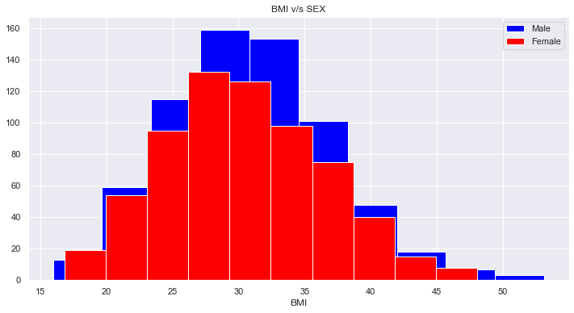
QUESTION 2 PROVE (OR DISPROVE) WITH STATISTICAL EVIDENCE THAT THE BMI OF FEMALES IS DIFFERENT FROM THAT OF MALES?
Through this we aim to understand if the BMI of Females and Males is different on comparison. In other words, does sex have an effect on BMI?
GRAPHICALLY: There doesn't seem to be a huge difference graphically.

Slide 48
QUESTION 2 PROVE (OR DISPROVE) WITH STATISTICAL EVIDENCE THAT THE BMI OF FEMALES IS DIFFERENT FROM THAT OF MALES?
Lets analyze this Statistically using 2 SAMPLE INDEPENDENT T TEST
NULL HYPOTHESIS(H0) : BMI of Females is NOT DIFFERENT than that of Males
ALTERNATE HYPOTHESIS (Ha) : BMI of Females IS DIFFERENT from that of Males.
BMI_Male = np.array(DataSet[DataSet['sex'] == 'male']['bmi'])
BMI_Female = np.array(DataSet[DataSet['sex'] == 'female']['bmi'])
test_stat1, p_value1 = stats.ttest_ind(BMI_Male,BMI_Female)
The p value is = 0.08997637178984932
Fail to reject Null hypothesis (Accept Null Hypothesis)
Observations : Null Hypothesis Accepted : BMI of Females is NOT DIFFERENT than that of Males

Slide 49
QUESTION 3 IS THE PROPORTION OF SMOKERS SIGNIFICANTLY DIFFERENT ACROSS REGIONS?
Through this we aim to understand if Smoking Population of policy holders is significantly different in the 4 regions
The REGION V/S SMOKERS graph in BIVARIATE ANALYSIS did not show a significant difference in the Smoking Population of the 4 regions.
We will now test it statistically using CHI SQUARE TEST OF INDEPENDENCE
NULL HYPOTHESIS(H0) : Proportion of Smokers is NOT significantly different across regions.
ALTERNATE HYPOTHESIS (Ha) : Proportion of Smokers IS significantly different across regions.
SMOKER no yes
REGION
northeast 257 67
northwest 267 58
southeast 273 91
southwest 267 58

Slide 50
QUESTION 3 IS THE PROPORTION OF SMOKERS SIGNIFICANTLY DIFFERENT ACROSS REGIONS?
tab2 = pd.crosstab(DataSet['region'],DataSet['smoker’])
chi, p_value2, dof, expected = chi2_contingency(tab2)
The p value is = 0.06171954839170541
Fail to reject Null hypothesis (Accept Null Hypothesis)
Observations : Null Hypothesis Accepted : Proportion of Smokers is NOT significantly different across regions.

Slide 51
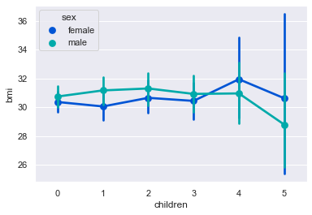
QUESTION 4 IS THE MEAN BMI OF WOMEN WITH NO CHILDREN, ONE CHILD AND TWO CHILDREN THE SAME? EXPLAIN YOUR ANSWER WITH STATISTICAL EVIDENCE
Through this we aim to understand if the BMI of women changes with respect to increasing number of children.
GRAPHICALLY: From the range of 0 - 2 children; women do not show significant difference in their mean BMI.

Slide 52
QUESTION 4 IS THE MEAN BMI OF WOMEN WITH NO CHILDREN, ONE CHILD AND TWO CHILDREN THE SAME? EXPLAIN YOUR ANSWER WITH STATISTICAL EVIDENCE
Lets analyse this statistically with ONE WAY ANOVA TEST using f_oneway
f_oneway:
The one-way ANOVA tests the null hypothesis that two or more groups have the same population mean. The test is applied to samples from two or more groups, possibly with differing sizes.
NULL HYPOTHESIS(H0) : Mean BMI of women with no children, one child and two children is SAME.
ALTERNATE HYPOTHESIS (Ha) : Mean BMI of women with no children, one child and two children is NOT SAME.
women_df = DataSet[DataSet['sex']=='female']
ZeroChi = np.array(women_df[women_df['children'] == 0 ]['bmi'])

Slide 53
QUESTION 4 IS THE MEAN BMI OF WOMEN WITH NO CHILDREN, ONE CHILD AND TWO CHILDREN THE SAME? EXPLAIN YOUR ANSWER WITH STATISTICAL EVIDENCE
OneChi = np.array(women_df[women_df['children'] == 1 ]['bmi'])
TwoChi = np.array(women_df[women_df['children'] == 2 ]['bmi'])
f_stat, p_value3 = stats.f_oneway(ZeroChi,OneChi,TwoChi)
The p value is = 0.7158579926754841
The f statistic value is = 0.3344720147757968
Fail to reject Null hypothesis (Accept Null Hypothesis)
Observations : Null Hypothesis Accepted : Mean BMI of women with no children, one child and two children is SAME.

Slide 54
THANK YOU

